Slide 1
Maths at Kettlefields

Slide 2
Aims of this afternoon
•To explore the main elements that can help children develop number sense and fluency when calculating.
•To discuss ways you can support your children at home, including games you can play.

Slide 4
What is Number Sense?
6 + 5 =
11 – 9 =
•Children with number sense can work fluently and flexibly with numbers
•They have a sense of what numbers mean and understand their relationship to one another
•They can use numbers in real world situations.
•It develops gradually as a result of exploring numbers, visualizing them in a variety of contexts, and relating them in ways that are not limited by traditional algorithms

Slide 5
The 4 Cs
These key elements are the basis for the development of children’s early number sense and future success in maths:
•Counting
•Cardinality
•Composition
•Comparison

Slide 6
Counting
“Knowing numbers” is often used to refer to a child being able to recite the names of numbers in ascending order.
However, rote memorisation does not equate to understanding.
3 rules of counting 1. Count everything once 2. Say the numbers in the right order 3. The last number you day is how many there are = the stopping number
One-To-One Correspondence
When counting, the concept of one-to-one correspondence is the understanding that each object being counted represents “one more.” It is important for children to be able to count out a number of objects from a larger group set of objects so they understand the stopping number.

Slide 7
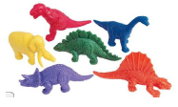
Progression in counting
1.Count things that are identical in appearance.
2.Count things that can be conceptualized as being the same, but aren’t identical. Vary by:
colour
b. other non- interfering variables
Only count (and calculate with) things with the same noun.

Slide 10
Counting activities and games
Songs and rhymes
•Five Little Ducks
•Five Little Men in a Flying Saucer
•Five Little Speckled Frogs
•Ten Fat Sausages
•Ten Little Indian Boys
•One, Two Three, Four, Five, Once I caught a fish alive

Slide 12
cardinality
Cardinality means the quantity or total number of items in a set . This can be determined by subitising (for very small sets) or counting. While subitising allows children to perceive the cardinality of small sets, counting requires them to understand that the last number in the counting sequence represents the quantity of the set.
‘The 8-ness of eight’

Slide 13
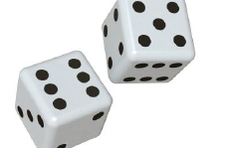
Cardinality
Subitising The process of immediately knowing how many objects are in a small group without needing to count them. Perceptual Subitising Being able to ‘just see’ how many are in a group, without counting.

Slide 19
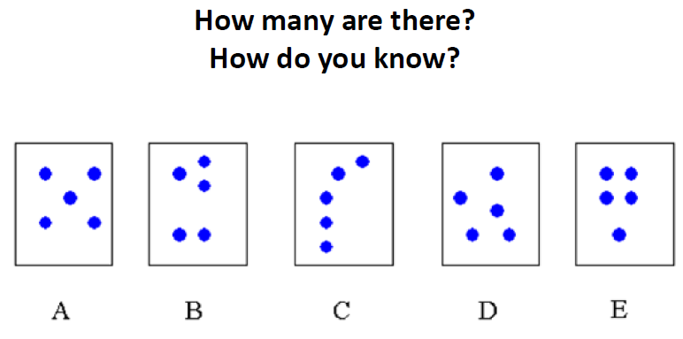

Slide 20
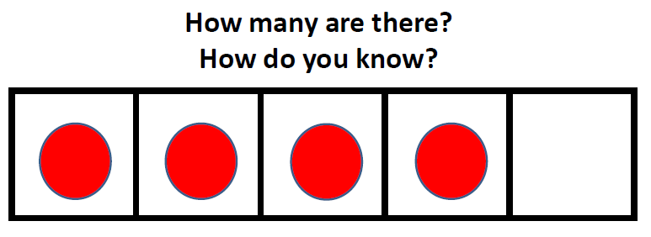

Slide 21
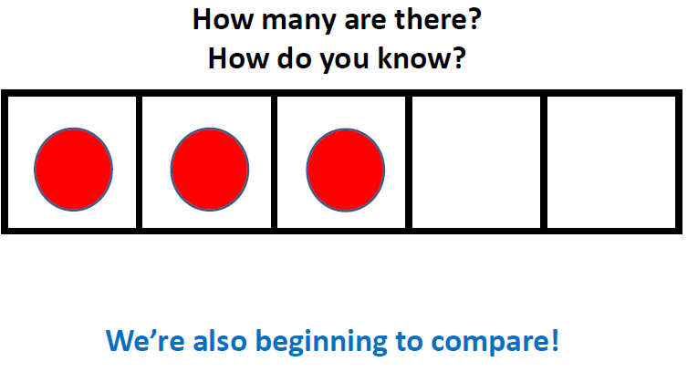

Slide 24
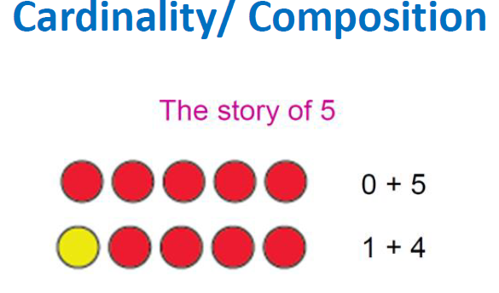

Slide 25
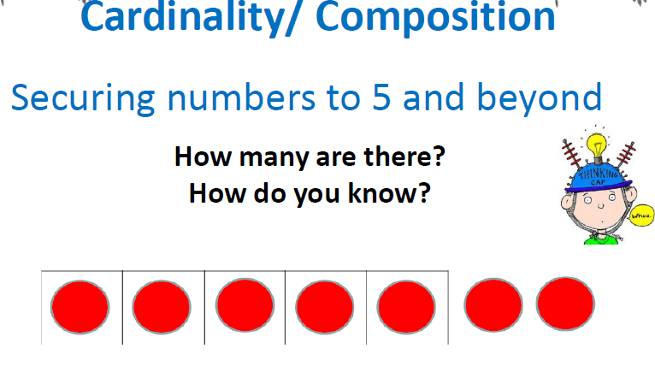

Slide 28
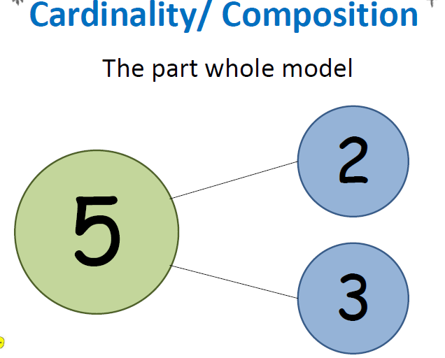

Slide 29
